Slide 1
CoVid-19
LESSON 5: Moving Forward
Find Press it to turn red when you aren’t talking.
Have a paper and pencil ready to use
HEALTH LITERACY WORK GROUP

Slide 2
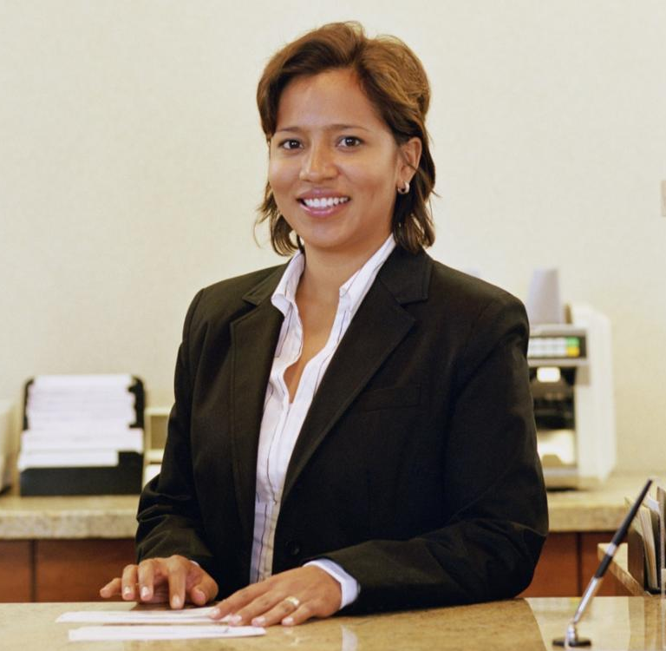
Going Back to Work? Juanita’s Worries
Juanita is feeling better after being sick for about a week. The doctor calls her and says that the county can now do more testing. She is an essential worker. She should be testing before she goes back to work. She goes to the health department and they put a long Q-tip up her nose. She gets a phone call from Zainab Mohamed, from the health department. She has CoVid-19. They want to know a list of everybody she has had contact with for the last ten days.
Zainab says they have to do “contact tracing” to let other people know they have been exposed.
Juanita is worried. Why do they want this information?

Slide 3
Some new public health words (we can read them together)
Public health : the science used to keep a community healthy
Infectious Disease/contagious disease: A disease that can go from one person to another by close contact
Exposure : Close contact (within 6 feet) to a person with a virus for at least 15 minutes
Contact tracing : a way of finding the people who are most likely to get sick to help them and keep them from infecting others. It is used to keep infectious diseases from spreading in a community

Slide 4
Matching
Exposure
A disease that can go from one person to another by close contact
a way of finding the people who are most likely to get sick
Close contact (within 6 feet) to a person with a virus for at least 15 minutes
the science used to keep a community healthy
Infectious Disease/contagious disease
Public health
Contact tracing

Slide 5
Some New Public Health Words
Antibodies: Small parts of our bodies that fight against infections
Immunity: Strong antibodies made to fight a particular infectious disease keep us from getting that disease
Asymptomatic: Not having any symptoms even though you have a virus
.Presymptomatic: Not having any symptoms when you first have a virus
Quarantine: Keeping someone with an infectious disease away from others so they don’t get sick

Slide 6
Matching
Keeping someone with an infectious disease away from others so they don’t get sick
Small parts of our bodies that fight against infections
Not having any symptoms when you first have a virus
Strong antibodies made to fight a particular infectious disease keep us from getting that disease
Not having any symptoms even though you have a virus
Antibodies
Immunity
Asymptomatic
.Presymptomatic
Quarantine

Slide 7
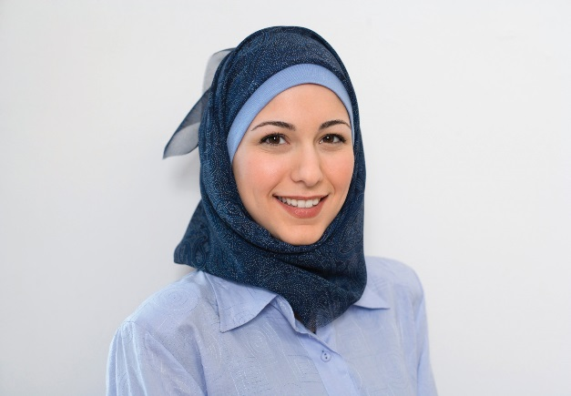
Contact Tracing and CoVid-19
Zainab Mohamed, the public health worker sets up a time to meet with Juanita on Zoom. She explains contact tracing
She says, “I need you to help me find people you know who may have been exposed to the virus, when they were too close to you while you were sick”
“Those people can quarantine and carefully watch to see if they have symptoms and to get help if they get CoVid-19. This helps to stop the spread”.

Slide 8
First Zainab shows Juanita a model of a spreading virus = = infected person = virus = person without virus

Slide 9
Then She Shows Her How Contact Tracing Stops the Spread

Slide 10
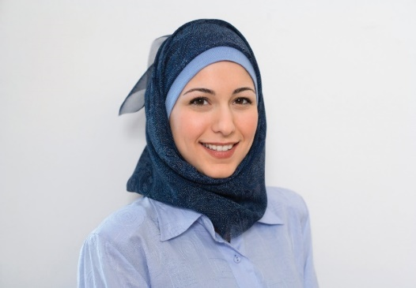
Let’s look at Juanita’s Contact Tracing Interview
Zainab says, “Since you have the virus I need you to think about anyone you were closer than 6 feet to for at least 15 minutes in the last ten days. They may have been exposed to the virus.
Juanita says “I was working at the bank ten days ago but I was not sick then.”
“Some people have the virus before they have symptoms (presymptomatic). So, we ask you for two days before you got sick. Some people with the virus never have symptoms (asymptomatic) which is why we are social distancing”

Slide 11
Pick one of the words and put your answers in the chat
a. Symptomatic b. Asymptomatic c. Presymptomatic
1. This word describes someone who has symptoms: _____________________.
2 Zainab asked Juanita to tell her who she had close contact with for the two days before she felt sick. She did this because she could have been _____________________
3. We know now that some people with CoVid-19 don’t have any symptoms. We call this: _________________________

Slide 12
“How can somebody be sick and not know it?”
“When the germs gets into your mouth, nose, or eyes they try to make more germs in your respiratory system. But we have antibodies inside us that try to keep the germs from making more germs. It’s like a war. If the antibodies are strong the germs lose. But if the antibodies are not as strong we get sick.”
1. What do germs try to do in our respiratory systems?
2. What do antibodies try to do to germs?
3. What happens if the antibodies are not as strong as the germs?

Slide 13
Antibodies, other diseases and age
“People who have other diseases or are over 65 years old often have antibodies that are overworked. That is why they can get severe symptoms.”
Juanita started to cry, “What about my mother?”
“Well, it sounds like she is healthy. I will go over the symptoms with her to make sure and show her what to look for. She will need to take her temperature twice a day. If she gets symptoms we will test her. She will need to be quarantined for 14 days from the last time she was closer to you than 6 feet. After 14 days she is safe from that exposure
“

Slide 14
We now know that CoVid-19 has many possible symptoms

Slide 15
Exposure Symptoms & Quarantine
Zainab says, “I will need to have the same talk with your family members and the list of people who you were close to for more than 15 minutes in the last ten days.”
Juanita says, “There is a thick glass between me and any customers at the bank and it doesn’t take 15 minutes to do their business. But,I had lunch with Sama and Miko on that first day. My boss also helped me with my cash drawer on that second day. After that, I was at home, so I just saw my family.

Slide 16
Exposure, Symptoms & Quarantine
Juanita finished the list of contacts. Zainab says, “I will contact these people and tell them they may have been exposed on the day we put down. If they have symptoms they will be tested and we will look for their contacts. If not I will ask them to be in quarantine for 14 days from the exposure day. So it would be 4 more days of quarantine for Sama and Miko and 5 more days for Daniel, your boss.
Why is the quarantine longer for Daniel than for Sama and Miko?

Slide 17
Another worry for Juanita
“I feel terrible that I could have given this to anyone! What if they blame me for giving it to them!”
Zainab says, “You didn’t do anything wrong. In fact, you did everything right. As soon as you knew you stayed away from everybody. Besides I never tell anyone about you being sick or where they may have been exposed. So don’t worry about that.”
“Helping me find the people who may have been exposed will help to stop the spread. That is very important now as we get closer to going out of our houses.”
“I will check on you and your family in a few days. I am so glad you are feeling better. You can probably go back to work in a week. Do you have any questions?”

Slide 18
Juanita’s questions
“I have a lot of questions!”
“The first one is can I get this again?”
Zainab says, “So, CoVid-19 is a new disease and we are still learning about it. If you get some other coronaviruses you can get immunity. That is where your antibodies against that virus get very strong and you can’t get it again. But we just don’t know. But, we learn more everyday. So, I hope we can learn this soon.”

Slide 19
Juanita’s questions
“I am afraid to go to work. How do I know I am safe there? What should I look for and how can I protect myself?
Zainab says, “This is a very good question.” We have several ways to help keep us safe. You want your employer to encourage these things and you want to make sure you do them too. It is even more important when we no longer have the stay at home order!”
Practice Social Distancing + Wear a Mask in public + Don’t touch your face + Wash your hands + Clean and Disinfect Surfaces

Slide 20
Fill in the Blank
disinfect distancing mask hands face
1. Practice Social ________
2. Wear a ______ in public
3. Don’t touch your ______
4. Wash your ________
5. Clean and _________ Surfaces

Slide 21
Using Face Masks

Slide 23
Handwashing? https://youtu.be/3SfHdSHK-g0

Slide 24
Good Handwashing https://youtu.be/seA1wbXUQTs

Slide 25
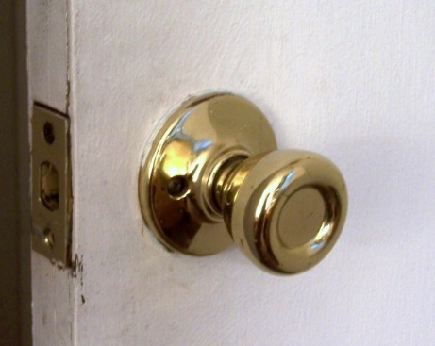
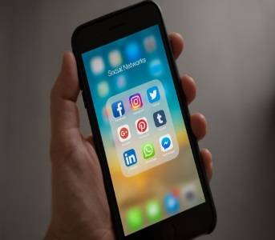
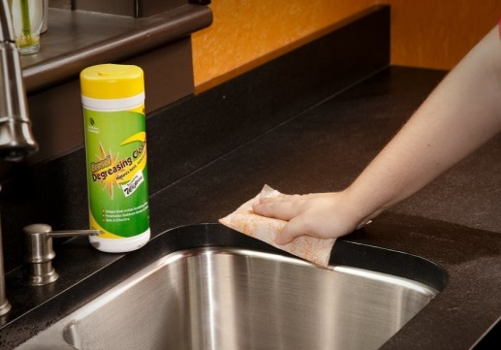
1. Clean dirty surfaces with soap and water
Clean and Disinfect What you Touch Often
2. Disinfect with an EPA-registered disinfectant with “human coronavirus” on the label. It should have 70% alcohol or bleach in it.
3. Read the instructions and the warnings. Use only on the surfaces listed on the label. Never use disinfectants on your skin, or in your body, or on your food it kills germs and it will hurt your body
4. Let the surface dry on its own

Slide 26
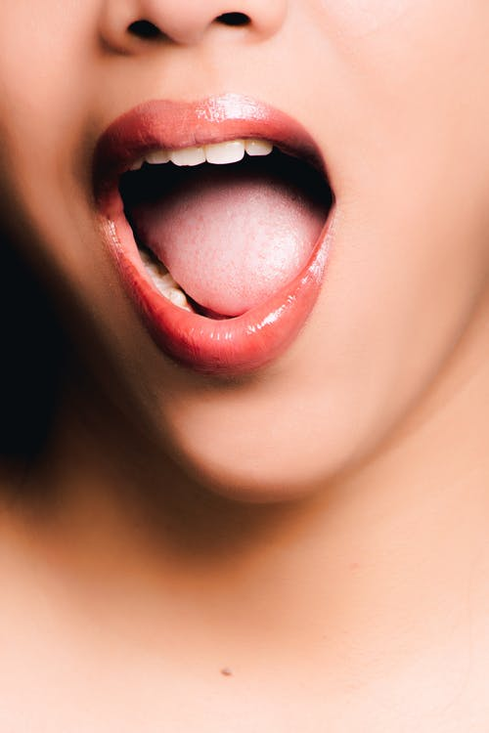
What Should We Disinfect?

Slide 27
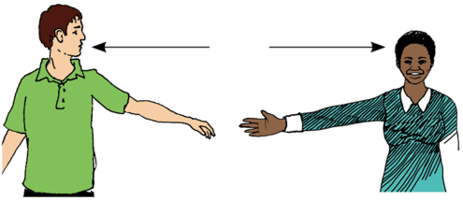
We still need to social distance!
Hesperian. (2020). https://en.hesperian.org/hhg/Coronavirus

Slide 28
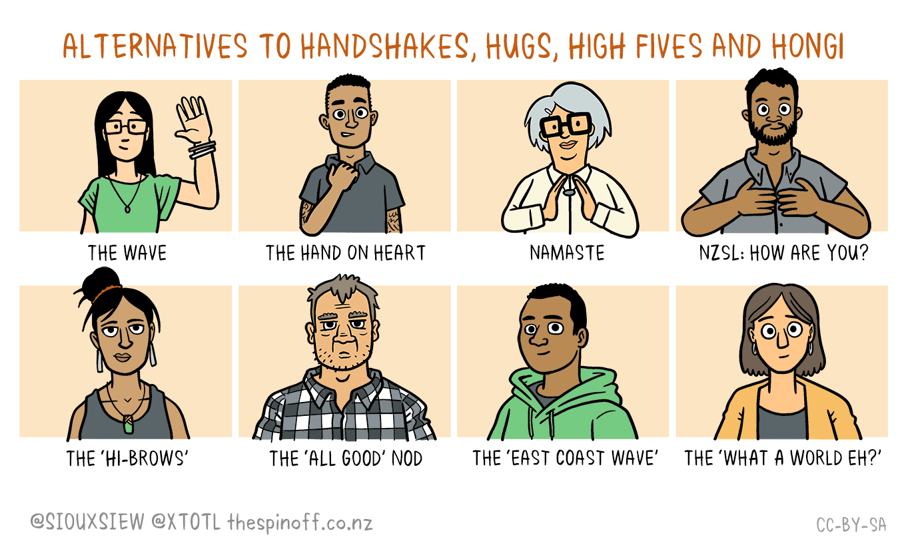
We still need to social distance!

Slide 29
Safe at Work
Zainab says, “Your workplace should”:
1. Rearrange all working areas or schedules to make space for social distancing.
2. Encourage employees to go home if they don’t feel well
Require employees to wear a face mask
Supply enough hand sanitizer and hand soap for employees to clean between customers.
Clean the office frequently and after everyone leaves.

Slide 30
Staying Safe
Juanita is so glad that she met Zainab and asked these questions. But she says, “Will we be doing these things forever?!”
Zainab says, “No, we will watch closely as we all go back to working, shopping and spending time with others. As fewer and fewer people get sick we will start to be closer, wear masks less and stop disinfecting so much. But we should always wash our hands.”
They both laughed.

Slide 31
Think about Going Back to work or being around others
Are you still practicing good handwashing?
How will you social distance at work, around other people?
Where and when will you wear a face mask?
What and when will you disinfect?
When do you have to be the most careful to not touch your face?

Slide 32
Questions????
Thank you!!!
Developed by:
Dr. Doris Ravotas
Fulbright Specialist
Master Faculty Specialist
School of Interdisciplinary Health Programs
College of Health and Human Services
KLC Fellow and Health Literacy Work Group Leader
Email: doris.ravotas@wmich.edu
HEALTH LITERACY WORK GROUP

Slide 33
Stay Healthy!
Developed by:
Dr. Doris Ravotas
Fulbright Specialist
Master Faculty Specialist
School of Interdisciplinary Health Programs
College of Health and Human Services
KLC Fellow and Health Literacy Work Group Leader
Email: doris.ravotas@wmich.edu
HEALTH LITERACY WORK GROUP

Slide 34
References
Babylon Health. (2020). Coronavirua: Proper handwashing.. Retrieved on 4/26/20 https://youtu.be/seA1wbXUQTs
Babylon Health. (2020). Coronavirua: Why it is important to wash your hands properly.. Retrieved on 4/26/20 from https://youtu.be/3SfHdSHK-g0
CDC. (2020). Community mitigation strategies. Retrieved on 4/26/20 from https://www.cdc.gov/coronavirus/2019-ncov/downloads/community-mitigation-strategy.pdf
CDC. (2020). Population health training. Retrieved on 4/26/20 from https://www.cdc.gov/pophealthtraining/whatis.html
CDC. (2020). Public health recommendations. Retrieved on 4/26/20 from https://www.cdc.gov/coronavirus/2019-ncov/php/public-health-recommendations.html
EPA. (2020). Six steps for safe and effective disinfectant use. Retrieved on 4/26/20 from https://www.epa.gov/pesticide-registration/six-steps-safe-effective-disinfectant-use
Hesperian Health (2020). Social Distancing (image). Retrieved on 4/17/20 at https://en.hesperian.org/hhg/Coronavirus
Lau, T. & Johnson. L. (2012). Muslin woman image. Business and the legal and ethical environment. CC. Retrieved on 4/26/20 from https://2012books.lardbucket.org/books/business
and-the-legal-and-ethical-environment/s15-02-enforcement-of-title-vii.html https://2012books.lardbucket.org/books/business-and-the-legal-and-ethical-environment/s15-02-
enforcement-of-title-vii.html
N.A. (2019). Older Latina(photograph). Retrieved on 4/20/20 from https://en.wikipedia.org/wiki/Castanets. CC
N.A. (2019). Human leg(image). Retrieved from http://pngimg.com/download/4804
N.A. (2020). Zucchini.(image). Retrieved from https://en.wikipedia.org/wiki/Zucchini
N/A. (2019). Woman opening her mouth. Retrieved on 4/26/20 from http://pngimg.com/download/7502

Slide 35
References (cont.)
Wiles, S. & Morris, T. (2020). What does ‘level two’ mean – and why does it matter? Retrieved on 4/26/20 from: https://thespinoff.co.nz/politics/22-03-2020/siouxsie-wiles-toby-morris
-what-does-level-two-mean-and-why-does-it-matter/. CC-by-SA.
Wiles, S. & Morris, T. (2020). Potential Symptoms of CoVid-19. Retrieved on 4/26/20 from https://thespinoff.co.nz/society/30-04-2020/siouxsie-wiles-toby-morris-why-getting-tested-
quickly-matters-so-much/. CC-by-SA.
Wiles, S. & Morris, T. (2020). Why contact tracing is so crucial to moving out of lockdown? Retrieved on 4/26/20 fromhttps://thespinoff.co.nz/society/18-04-2020/siouxsie-wiles-toby
-morris-why-contact-tracing-is-so-crucial-to-moving-out-of-lockdown/. CC-by-SA.
Wiles, S. & Morris, T. (2020). Should we all be wearing face masks to prevent CoVid-19 spread? Retrieved on 4/26/20 from: https://thespinoff.co.nz/society/06-04-2020/siouxsie-wiles-
toby-morris-should-we-all-be-wearing-face-masks-to-prevent-covid-19-spread/ CC-by-SA.
Wiles, S. & Morris, T. (2020). What does ‘level two’ mean – and why does it matter? Retrieved on 4/26/20 from: https://thespinoff.co.nz/politics/22-03-2020/siouxsie-wiles-toby-morris-
what-does-level-two-mean-and-why-does-it-matter/. CC-by-SA.

